Slide 1

SE401 - Software Quality Assurance and Testing
Unit Testing and JUnit

Slide 2
SE 401
Reading:
JUnit documentation
http://junit.org/junit5
https://junit.org/junit5/docs/snapshot/user-guide/
An introductory tutorial
http://www.vogella.com/tutorials/JUnit/article.html
Using JUnit in Eclipse
https://www.eclipse.org/community/eclipse_newsletter/2017/october/article5.php
https://www.educative.io/courses/java-unit-testing-with-junit-5/B892KY261z2
How to use JUnit with NetBeans
https://testingandlearning.home.blog/2019/01/30/how-to-use-junit-with-netbeans/

Slide 3
Outline
Unit Testing and JUnit
Assertion Methods
JUnit Best Practices

Slide 4
Unit Testing and JUnit

Slide 5
Unit Testing
Testing of an individual software unit
usually a class & its helpers
Focus on the functions of the unit
functionality, correctness, accuracy
Usually carried out by the developers of the unit
can use black-box and white-box techniques to design test cases

Slide 6
Unit Testing
Unit testing: Looking for errors in a subsystem in isolation.
Generally a "subsystem" means a particular class or object.
The Java library JUnit helps us to easily perform unit testing.
The basic idea:
For a given class Foo, create another class FooTest to test it, containing various "test case" methods to run.
Each method looks for particular results and passes / fails.
JUnit provides "assert" commands to help us write tests.
The idea: Put assertion calls in your test methods to check things you expect to be true. If they aren't, the test will fail.

Slide 7
Why JUnit
Allows you to write code faster while increasing quality
Elegantly simple
Check their own results and provide immediate feedback
Tests are inexpensive
Increase the stability of software
Developer tests
Written in Java
Free
Gives proper understanding of unit testing

Slide 8
JUnit
JUnit helps the programmer:
Define and execute tests and test suites
Formalize requirements and clarify architecture
Write and debug code
Integrate code and always be ready to release a working version
What JUnit does
JUnit runs a suite of tests and reports results

Slide 9
JUnit
JUnit is a framework for writing unit tests
A unit test is a test of a single class
A test case is a single test of a single method
A test suite is a collection of test cases
Unit testing is particularly important when software requirements change frequently
Code often has to be refactored to incorporate the changes
Unit testing helps ensure that the refactored code continues to work

Slide 10
A JUnit test class
import static org.junit.jupiter.api.Assertions.*;
import org.junit.jupiter.api.Test;
class name {
...
@Test
void name() { // a test case method
...
}
}
A method with @Test is flagged as a JUnit test case.
All @Test methods run when JUnit runs your test class.

Slide 11
The structure of a test method
A test method doesn’t return a result
If the tests run correctly, a test method does nothing
If a test fails, it throws an AssertionFailedError
The JUnit framework catches the error and deals with it; you don’t have to do anything

Slide 12
Test suites
In practice, you want to run a group of related tests (e.g. all the tests for a class)
To do so, group your test methods in a class with annotations @SelectPackages or @SelectClasses

Slide 13
Organize The Tests
Create test cases in the same package as the code under test
For each Java package in your application, define a TestSuite class that contains all the tests for validating the code in the package
Define similar TestSuite classes that create higher-level and lower-level test suites in the other packages (and sub-packages) of the application
Make sure your build process include the compilation of all tests

Slide 14
JUnit Best Practices
Separate production and test code
But typically in the same packages
Compile into separate trees, allowing deployment without tests
Don’t forget OO techniques, base classing
Test-driven development
Write failing test first
Write enough code to pass
Refactor
Run tests again
Repeat until software meets goal
Write new code only when test is failing

Slide 15
JUnit Best Practices
Tests need failure atomically (ability to know exactly what failed).
Each test should have a clear, long, descriptive name.
Assertions should always have clear messages to know what failed.
Write many small tests, not one big test.
Each test should have roughly just 1 assertion at its end.
Test for expected errors / exceptions.
Choose a descriptive assert method, not always assertTrue.
Choose representative test cases from equivalent input classes.
Avoid complex logic in test methods if possible.

Slide 16
Problems with unit testing
JUnit is designed to call methods and compare the results they return against expected results
This ignores:
Programs that do work in response to GUI commands
Methods that are used primarily to produce output
Heavy use of JUnit encourages a “functional” style, where most methods are called to compute a value, rather than to have side effects
This can actually be a good thing
Methods that just return results, without side effects (such as printing), are simpler, more general, and easier to reuse

Slide 17
An Introduction to JUnit Part 1: The Basics

Slide 18
JUnit – Java Unit Testing Tool
A unit testing tool for Java programs
JUnit home page: http://junit.org
A simple framework to write repeatable tests
Test cases, test suites, assertions, etc.,
Automated execution of test suites
Run all test cases, generate reports
Development methodology neutral
Often used in agile development/test-driven development

Slide 19
JUnit 5
Requires Java 8 (or higher) at runtime
Can still test code that has been compiled with previous versions of the JDK
Supported by popular IDEs
IntelliJ IDEA
Eclipse
NetBeans
Visual Studio Code
Supported by build tools
Gradle
Maven
Ant
Notes:
Current version 4.11 (Jan, 2014)

Slide 20
Running JUnit
JUnit has been integrated into most IDE’s
We will use the latest Eclipse/NetBeans IDE
Download and install Eclipse/NetBeans IDE for Java Developers
JUnit can also be run independently
Command-line, builder server
Using a simple build tool Ant
You can use both methods of running JUnit.

Slide 21
Test Case Verdicts
A verdict is the result of executing a single test case.
Pass
The test case execution was completed
The function being tested performed as expected
Fail
The test case execution was completed
The function being tested did not perform as expected
Error
The test case execution was not completed, due to
an unexpected event, exceptions, or
improper set up of the test case, etc.

Slide 22
JUnit Tests
A JUnit test is represented as a class (test class).
Each test case is a method in a test class.
A typical test case does the following
create some objects/data to test
do something interesting with the objects
determine pass or fail based on the results
A test suite may consist of multiple test classes.

Slide 23
JUnit Assertions
Assertions are Boolean expressions
An AssertionFailedError is thrown if the assertion is false
Can check for many conditions, such as
equality of objects and values
identity of references to objects
Determine the test case verdict
Pass: all assertions are true
Fail: one or more assertions are false

Slide 24
A Simple JUnit Test Case
/** Test of setName() method, of class Value */
@Test
public void createAndSetName() {
Value v1 = new Value();
v1.setName("Y");
String expected = "Y";
String actual = v1.getName();
assertEquals(expected, actual);
}

Slide 25
A Simple JUnit Test Case
/** Test of setName() method, of class Value */
@Test
public void createAndSetName() {
Value v1 = new Value();
v1.setName("Y");
String expected = "Y";
String actual = v1.getName();
Assert.assertEquals(expected, actual);
}
Identify this Java method
as a test case

Slide 26
A Simple JUnit Test Case
/** Test of setName() method, of class Value */
@Test
public void createAndSetName() {
Value v1 = new Value();
v1.setName("Y");
String expected = "Y";
String actual = v1.getName();
Assert.assertEquals(expected, actual);
}
Confirm that setName
saves the specified name in the Value object

Slide 27
A Simple JUnit Test Case
/** Test of setName() method, of class Value */
@Test
public void createAndSetName() {
Value v1 = new Value();
v1.setName("Y");
String expected = "Y";
String actual = v1.getName();
Assert.assertEquals(expected, actual);
}
Check to see that the
Value object really
did store the name

Slide 28
A Simple JUnit Test Case
/** Test of setName() method, of class Value */
@Test
public void createAndSetName() {
Value v1 = new Value();
v1.setName("Y");
String expected = "Y";
String actual = v1.getName();
Assert.assertEquals(expected, actual);
}
Assert that the expected and actual should be equal. If not, the test case should fail.

Slide 29
Organization of JUnit Test
Each test method represents a single test case
can independently have a verdict (pass, error, fail).
The test cases for a class under test (CUT) are usually grouped together into a test class.
Naming convention:
Class under test: Value
JUnit test for the class: ValueTest
Test classes are sometimes placed in a separate package.

Slide 30
Using JUnit in Eclipse/NetBeans
Download and install JDK
Download and install Eclipse/NetBeans IDE for Java Developers
JUnit is included in Eclipse/NetBeans

Slide 31
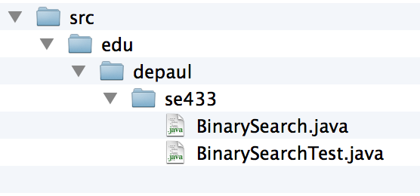
Run JUnit in Eclipse: An Example
Contents of JUnit1
Download the Sample Code from Moodle
JUnit1.zip
Unzip to the Eclipse
workspace folder
A subfolder named
JUnit1
The example contains
edu.depaul.se433.BinarySearch.java
edu.depaul.se433.BinarySearchTest.java
[see JUnit1.zip]

Slide 32
The Example Program: The Class Under Test
public class BinarySearch {
public static int search(int[] a, int x) {
…
}
public static int checkedSearch(int[] a, int x) {
…
}
}

Slide 33
The JUnit Test
public class BinarySearchTest {
@Test
public void testSearch1() {
int[] a = { 1, 3, 5, 7 };
assertTrue(search(a, 3) == 1);
}

Slide 34
The JUnit Test (cont’d)
@Test
public void testSearch2() {
int[] a = { 1, 3, 5, 7 };
assertTrue(search(a, 2) == -1);
}
@Test
public void testCheckedSearch1() { … }
@Test
public void testCheckedSearch2() { … }
@Test
public void testCheckedSearch3() { … }
}

Slide 35
Run JUnit in Eclipse: An Example
Start Eclipse IDE
New Java Project
Project name: JUnit1
Important: The project name matches the name of the folder that contains the sample code

Slide 36
Run JUnit in Eclipse: An Example
Click “Next”
Java Settings
Click “Libraries”
Click “Add Library …”

Slide 37
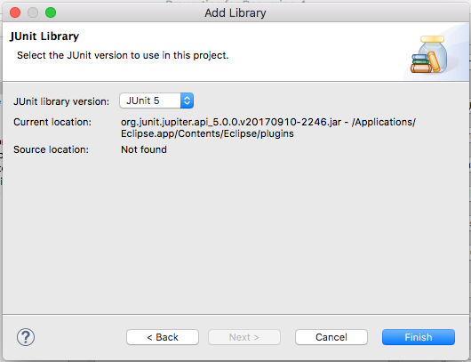
Run JUnit in Eclipse: An Example
Add Library
Choose “JUnit”
JUnit Library
Choose “JUnit 5”
Click “Finish”

Slide 38
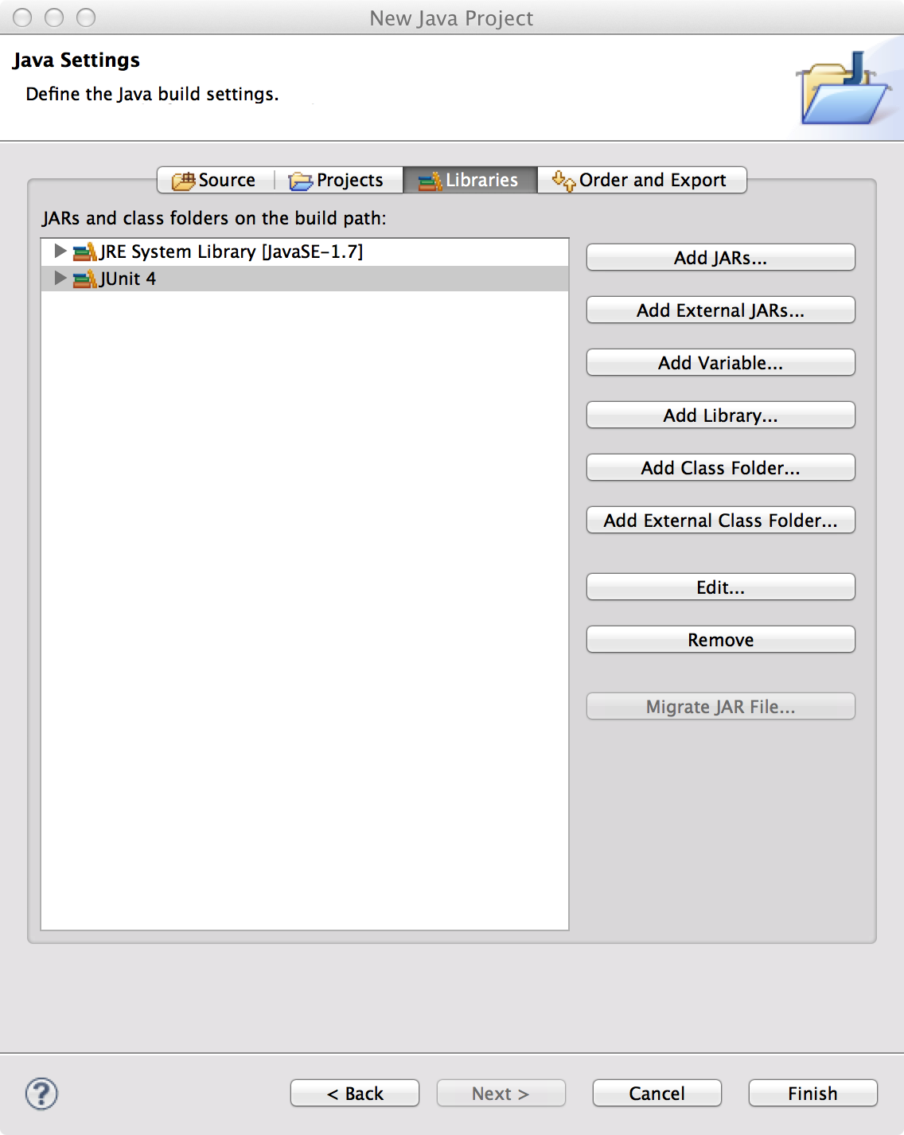
Run JUnit in Eclipse: An Example
Click “Finish”

Slide 39
Run JUnit in Eclipse: An Example
Run as
JUnit test

Slide 40
Run JUnit in Eclipse: An Example

Slide 41
Assertion Methods

Slide 42
Assertions in Test Cases
During execution of a test case:
If an assertion is true,
Execution continues
If any assertion is false,
Execution of the test case stops
The test case fails
If an unexpected exception is encountered,
The verdict of the test case is an error.
If all assertions were true,
The test case passes.

Slide 43
Assertion Methods: Boolean Conditions
Static methods defined in org.junit.Assert
Assert a Boolean condition is true or false
assertTrue(condition)
assertFalse(condition)
Optionally, include a failure message assertTrue(message, condition)
assertFalse(message, condition)
Examples
assertTrue(search(a, 3) == 1);
assertFalse(“Failure: 2 is not in array.”, search(a, 2) >= 0);

Slide 44
Assertion Methods: Null Objects
Assert an object references is null or non-null
assertNull(object)
assertNotNull(object)
With a failure message
assertNull(message, object)
assertNotNull(message, object)
Examples
assertNotNull(”Should not be null.", new Object());
assertNull(”Should be null.", null);

Slide 45
Assertion Methods: Object Identity
Assert two object references are identical
assertSame(expected, actual)
True if: expected == actual
assertNotSame(expected, actual)
True if: expected != actual
The order does not affect the comparison,
But, affects the message when it fails
With a failure message
assertSame(message, expected, actual)
assertNotSame(message, expected, actual)

Slide 46
Assertion Methods: Object Identity
Examples
assertNotSame("Should not be same.",
new Object(), new Object());
Integer num1 = Integer.valueOf(2013);
assertSame("Should be same.", num1, num1);
Integer num2 = Integer.valueOf(2014);
assertSame("Should be same.", num1, num2);
java.lang.AssertionError:
Should be same. expected same:<2013> was not:<2014>

Slide 47
Assertion Methods: Object Equality
Assert two objects are equal:
assertEquals(expected, actual)
True if: expected.equals( actual )
Relies on the equals() method
Up to the class under test to define a suitable equals() method.
With a failure message
assertEquals(message, expected, actual)

Slide 48
Assertion Methods: Object Equality
Examples
assertEquals("Should be equal.", "JUnit", "JUnit");
assertEquals("Should be equal.", "JUnit", "Java");
org.junit.ComparisonFailure:
Should be equal. expected:<J[Unit]> but was:<J[ava]>

Slide 49
Assertion Methods: Equality of Arrays
Assert two arrays are equal:
assertArrayEquals(expected, actual)
arrays must have same length
Recursively check for each valid index i,
assertEquals(expected[i],actual[i])
or
assertArrayEquals(expected,actual)
With a failure message
assertArrayEquals(message, expected, actual)

Slide 50
Assertion Methods: Equality of Arrays
Examples
int[] a1 = { 2, 3, 5, 7 };
int[] a2 = { 2, 3, 5, 7 };
assertArrayEquals("Should be equal", a1, a2);
int[][] a11 = { { 2, 3 }, { 5, 7 }, { 11, 13 } };
int[][] a12 = { { 2, 3 }, { 5, 7 }, { 11, 13 } };
assertArrayEquals("Should be equal", a11, a12);

Slide 51
Floating Point Values
Beware of problems with comparisons
How to compare two floating numbers
Never do the following: float a, b; . . . if ( a == b)
Why? Floating point arithmetic is not precise.
What is your limit of accuracy of the computer?
Is it 4.0000000 or 3.9999999 or 4.0000001 ?
Comparison is to subtract one of the numbers and look at the remainder. Hence to compare two floating numbers you must have a range/limit/delta.

Slide 52
Assertion Methods: Floating Point Values
For comparing floating point values (double or float)
assertEquals requires an additional parameter delta.
assertEquals(expected, actual, delta)
assertEquals(message, expected, actual, delta)
The assertion evaluates to true if
Math.abs( expected – actual ) <= delta
Example:
double d1 = 100.0, d2 = 99.99995;
assertEquals(“Should be equal within delta.”, d1, d2, 0.0001);

Slide 53
Exception Testing
A.k.a., robustness testing
The expected outcome of a test is an exception.
checkedSearch(null, 1);
public static int checkedSearch(int[] a, int x) {
if (a == null || a.length == 0)
throw
new IllegalArgumentException("Null or empty array.");
…
}

Slide 54
Exception Testing: Specify the Excepted Exception
Specify an expected exception in a test case
A particular class of exception is expected to occur
The verdict
Pass: if the expected exception is thrown
Fail: if no exception, or an unexpected exception
@Test
void exceptionTesting() {
Exception exception = assertThrows(ArithmeticException.class, () ->
calculator.divide(1, 0));
assertEquals("/ by zero", exception.getMessage());
}

Slide 55
Exception Testing: The fail() Assertion
Assertion methods
fail()
fail(message)
Unconditional failure
i.e., it always fails if it is executed
Used in where it should not be reached
e.g., after a statement, in which an exception should have been thrown.

Slide 56
Exception Testing: Use fail() Assertion
Catch exceptions, and use fail() if not thrown
Allows
inspecting specific messages/details of the exception
distinguishing different types of exceptions
@Test
public void testCheckedSearch3() {
try {
checkedSearch(null, 1);
fail("Exception should have occurred");
} catch (IllegalArgumentException e) {
assertEquals(e.getMessage(), "Null or empty array.");
}
}

Slide 57
Readings and References
JUnit documentation
http://junit.org
An introductory tutorial
http://www.vogella.com/tutorials/JUnit/article.html

Slide 58
Summary: Key Concepts
Test Cases play an important role in Software Testing Life-cycle. Make sure they are correct and cover all possible situations.
Unit testing refers to the practice of testing certain functions and areas – or units – of our code. This gives us the ability to verify that our functions work as expected.
Testing needs to be thorough
Eclipse/NetBeans provides a platform for doing unit tests using JUnit as a built-in feature.

Slide 59
JUnit Best Practices

Slide 60
JUnit Best Practices
Each test case should be independent.
Test cases should be independent of execution order.
No dependencies on the state of previous tests.

Slide 61
JUnit Test Fixtures
The context in which a test case is executed.
Typically include:
Common objects or resources that are available for use by any test case.
Activities to manage these objects
Set-up: object and resource allocation
Tear-down: object and resource de-allocation

Slide 62
Set-Up
Tasks that must be done prior to each test case
Examples:
Create some objects to work with
Open a network connection
Open a file to read/write

Slide 63
Tear-Down
Tasks to clean up after execution of each test case.
Ensures
Resources are released
the system is in a known state for the next test case
Clean up should not be done at the end of a test case,
since a failure ends execution of a test case at that point

Slide 64
Method Annotations for Set-Up and Tear-Down
@BeforeEach annotation: set-up
code to run before each test case.
@AfterEach annotation: Teardown
code to run after each test case.
will run regardless of the verdict, even if exceptions are thrown in the test case or an assertion fails.
Multiple annotations are allowed
all methods annotated with @BeforeEach will be run before each test case
but no guarantee of execution order

Slide 65
Example: Using a File as a Test Fixture
public class OutputTest {
private File output;
@BeforeEach
public void createOutputFile() {
output = new File(...);
}
@AfterEach
public void deleteOutputFile() {
output.close();
output.delete();
}
@Test
public void test1WithFile() {
// code for test case
…
}
@Test
public void test2WithFile() {
// code for test case
…
}
}

Slide 66
Method Execution Order
createOutputFile()
test1WithFile()
deleteOutputFile()
createOutputFile()
test2WithFile()
deleteOutputFile()
Not guaranteed:
test1WithFile runs before test2WithFile

Slide 67
Once-Only Set-Up
@BeforeAll annotation on a static method
one method only
Run the method once only for the entire test class
before any of the tests, and
before any @BeforeEach method(s)
Useful for starting servers, opening connections, etc.
No need to reset/restart for each test case
Shared, non-destructive
@BeforeAll
public static void anyName() {
// class setup code here
}

Slide 68
Once-Only Tear-Down
@AfterAll annotation on a static method
one method only
Run the method once only for the entire test class
after any of the tests
after any @AfterEach method(s)
Useful for stopping servers, closing connections, etc.
@AfterAll
public static void anyName() {
// class clean up code here
}

Slide 69
Timed Tests
Useful for simple performance test
Network communication
Complex computation
The @Timeout annotation
Time unit defaults to seconds but is configurable
The test fails
if timeout occurs before the test method completes
@Test
@Timeout(5)
public void testLengthyOperation() {
...
}

Slide 70
JUnit 5 Unit Testing Framework
JUnit 5 Documentation
Use JUnit 5 annotations to mark test methods
Annotation | Description
@Test public void method() | The annotation @Test identifies that a method is a test method.
@BeforeEach public void method() | Will execute the method before each test. Can prepare the test environment (e.g. read input data, initialize the class).
@AfterEach public void method() | Will execute the method after each test. Can cleanup the test environment (e.g. delete temporary data, restore defaults).

Slide 71
JUnit 5 Unit Testing Framework
Annotation | Description
@BeforeAll public void method() | Will execute the method once, before the start of all tests. Can be used to perform time intensive activities, for example to connect to a database.
@AfterAll public void method() | Will execute the method once, after all tests have finished. Can be used to perform clean-up activities, for example to disconnect from a database.
@Timeout(5) | Fails if the method takes longer than 5 seconds.
@Timeout(value = 100, unit = TimeUnit.MILLISECONDS) | Fails if the method takes longer than 100 milliseconds

Slide 72
Parameterized Tests
Repeat a test case multiple times with different data
Define a parameterized test
Declared just like regular @Test methods but use the @ParameterizedTest annotation instead
Must declare at least one source that will provide the arguments for each invocation
Consume the arguments in the test method

Slide 73
Parameterized Test Example
@ParameterizedTest
@ValueSource(strings = { "racecar", "radar", "able was I ere I saw elba" })
void palindromes(String candidate) {
assertTrue(StringUtils.isPalindrome(candidate));
}

Slide 74
Readings and References
Junit 5 documentation
https://junit.org/junit5/docs/current/user-guide/

